Slide 1
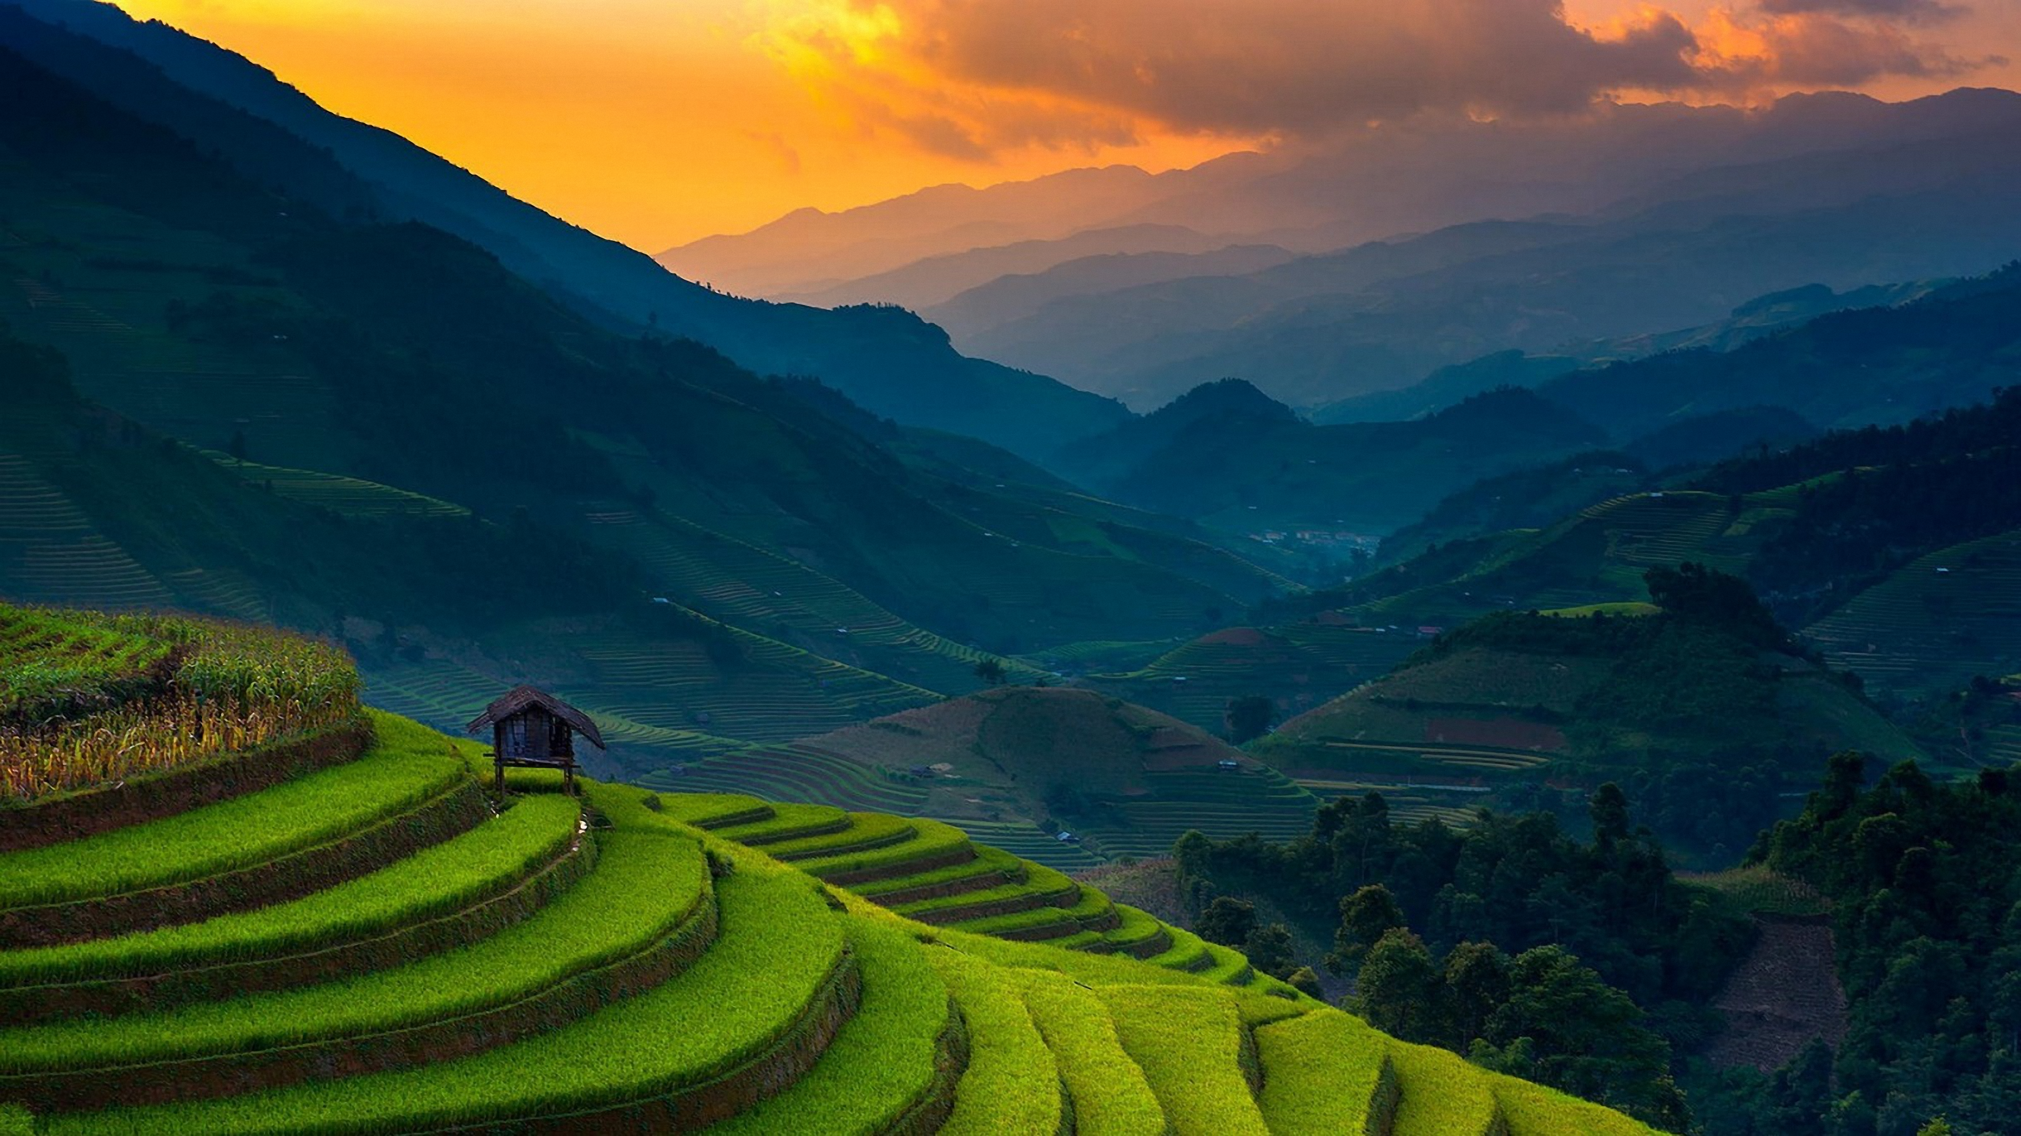
Your Local Home
HOLIDAY HOME NT

Slide 2
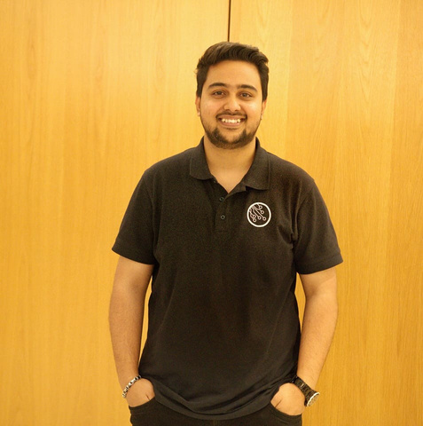

TEAM MEMBERS
Fahim
Synthia

Slide 3

PROBLEMS
Limited Services Provider in Remote Areas:
Insufficient Accommodation Options:
"Lack of Engaging Tourism Activities with Indigenous Communities"
Declining Visitor Numbers

Slide 4
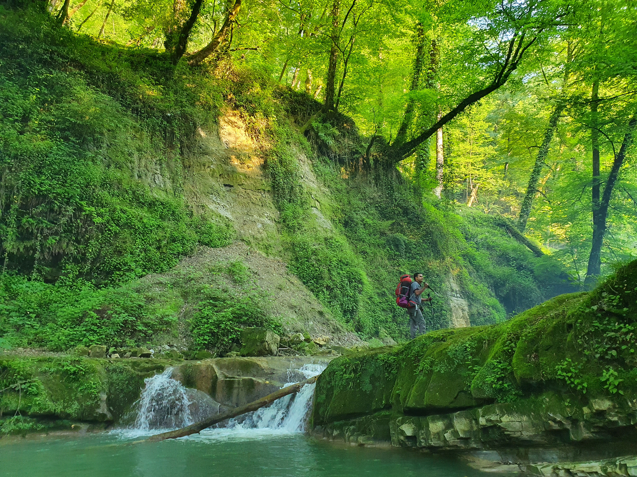
PROBLEMS 01
Limited Service Providers in Remote Areas
“A tourist planning to visit a remote part of the Northern Territory, such as a secluded Aboriginal community, might find it challenging to access basic services like guided tours, transportation, or cultural experiences due to the lack of service providers”

Slide 5

PROBLEM 02
Insufficient Accommodation Options
“A group of tourists traveling to explore NT’s remote wilderness may struggle to find suitable places to stay, especially in areas not near major towns or cities. This could also deter tourists from visiting remote regions, where accommodations are sparse, thereby reducing the potential economic benefits”

Slide 6

PROBLEM 03
Lack of Engaging Tourism Activities with Indigenous Communities
“Tourists in NT often miss authentic cultural experiences due to the lack of engaging activities with Indigenous communities. Visitors may feel disconnected from the region's rich cultural heritage without immersive opportunities like staying with local families or participating in traditional practices.”

Slide 7




EFFECTS OF PROBLEMS
Declining Visitor Numbers
1,701,000 Mar’23 1,646,000 Mar ‘24
-3.2%

Slide 8
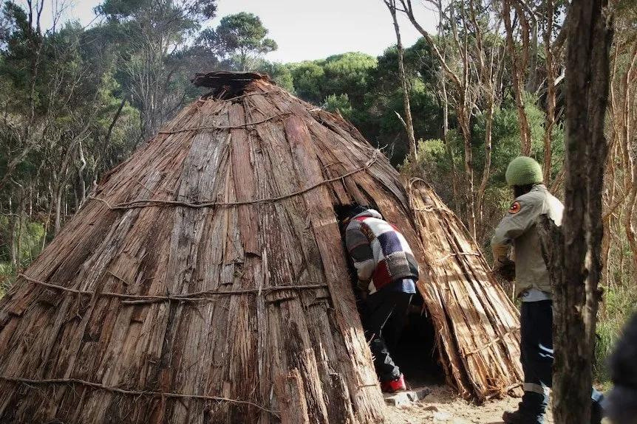
SOLUTIONS
Holiday Home NT
Holiday Home NT will allow tourists to stay with local families in their homes, allowing them to immerse themselves in the traditional Aboriginal lifestyle fully.
Tourists will live like locals, sharing meals, engaging in daily activities, and experiencing adventures such as fishing, hunting, and other culturally significant practices.

Slide 9
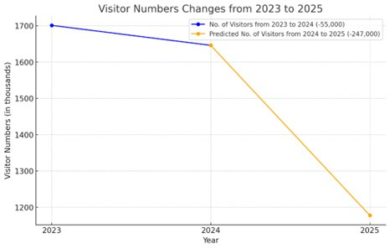
SOLUTIONS
Automated Visitor Prediction Model
- Using Machine Learning
A machine learning model to predict -
Future visitor trends
Total number of visitors
Specific locations they are likely to visit
Notes:
Source:
https://www.tourismnt.com.au/research-strategies/research/latest-visitor-data
https://www.tourismnt.com.au/research/tra-summary-sheet-archive

Slide 10
SOLUTIONS
Automated Visitor Prediction Model Why?
To help the NT government and our business
identify upcoming tourist hotspots and prioritize marketing efforts in those areas.
inform decisions on where to expand the Holiday Home service, optimize resources, and work with local communities to prepare for increased demand.

Slide 11
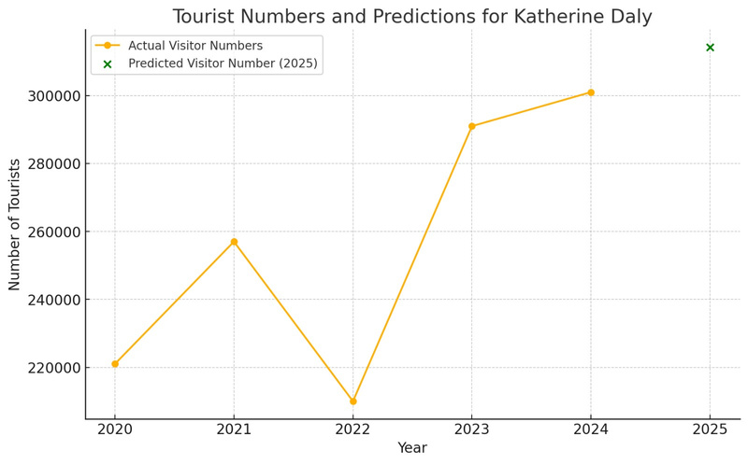
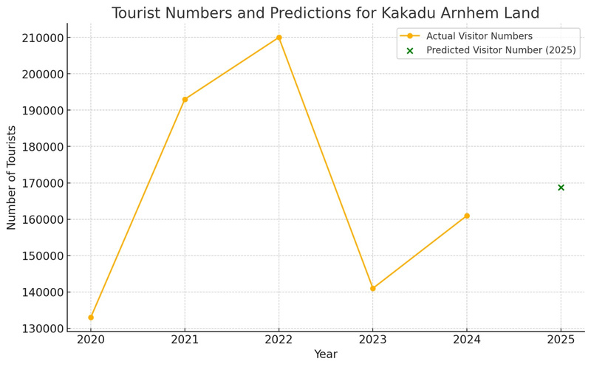
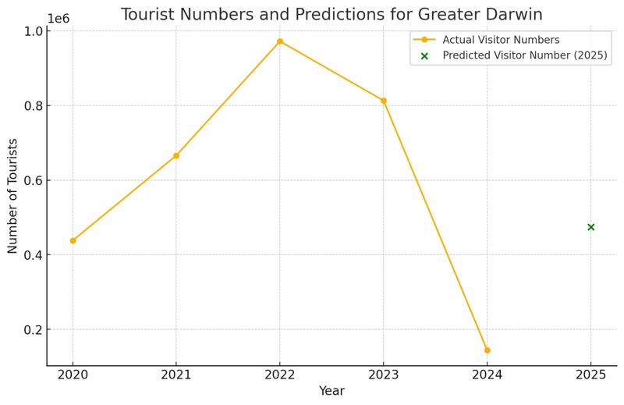
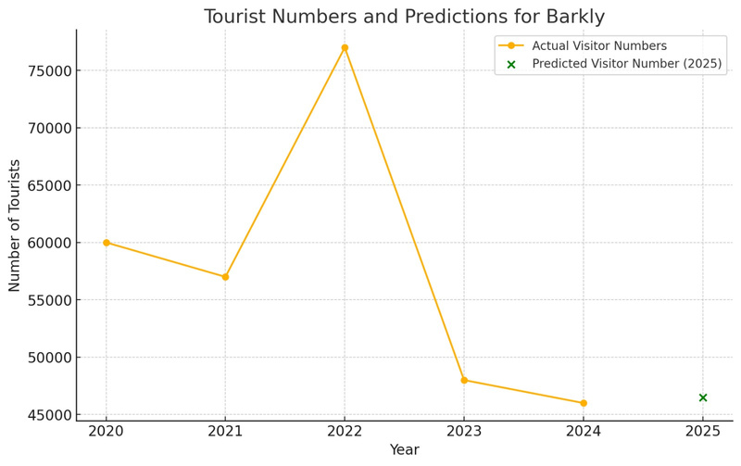
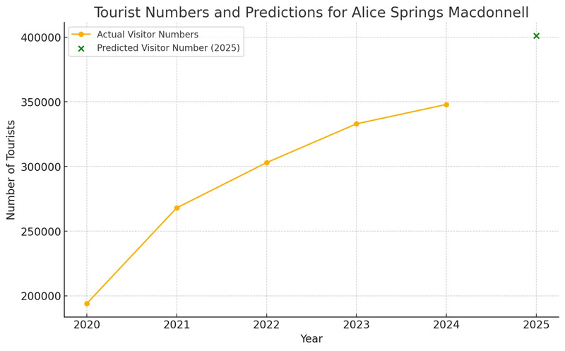
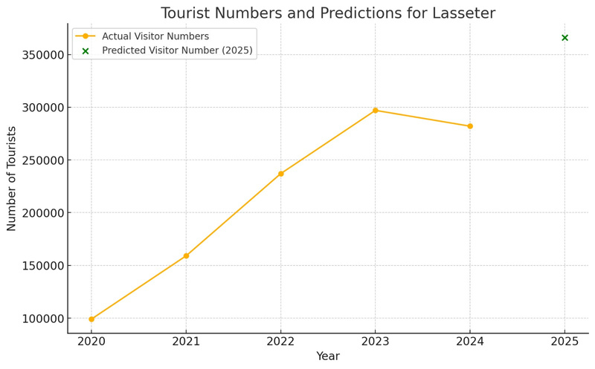
Automated Visitor Prediction Model
Trend number of Visitors & What places they are likely to visit

Slide 12

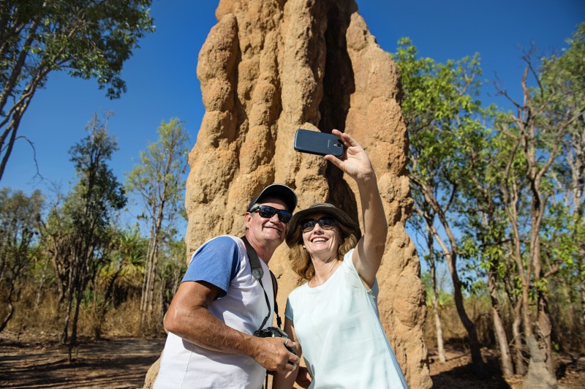

Market Analysis
Target Audience:
- Adventurous travellers, cultural enthusiasts, and eco-conscious tourists.
- Demographics: Aged 25-55, Medium to high-income travellers
Market Size:
5 % annual increase in remote eco-tourism globally.

Slide 13


Competitor Analysis
Competitor Analysis:
- Unique position as local home-stay experiences, with minimal direct competition.
- Competitors include traditional hotels and travel platforms offering basic facilities.

Slide 14

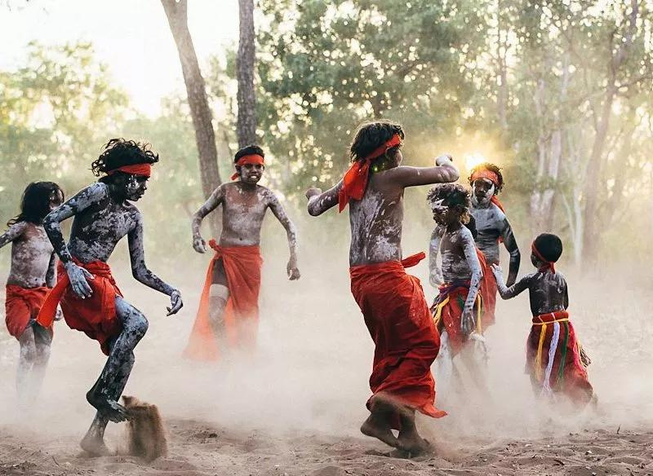




IMPACT
Empowerment of Indigenous Communities
Tourism Growth and Economic Impact
Unique and Authentic Tourism
Sustainable Tourism Practices

Slide 15






FEASIBILITY
Cost-Effective, Scalable Machine Learning Model
Resource Efficiency
Ready Local Population Base
Minimal Upfront Investment
Alignment with Global Sustainability Goals

Slide 16
Associated Costs and Price per Booking
Cost Category | Estimated Cost (AUD)
Host Training | 12,000
Website Creation | 8,000
Automated Prediction Model | 16,000
Support for Registered Hosts | 6,000
Promotion | 10,000
Other Expenses | 6,000
Price Per Booking | 1,400

Slide 17
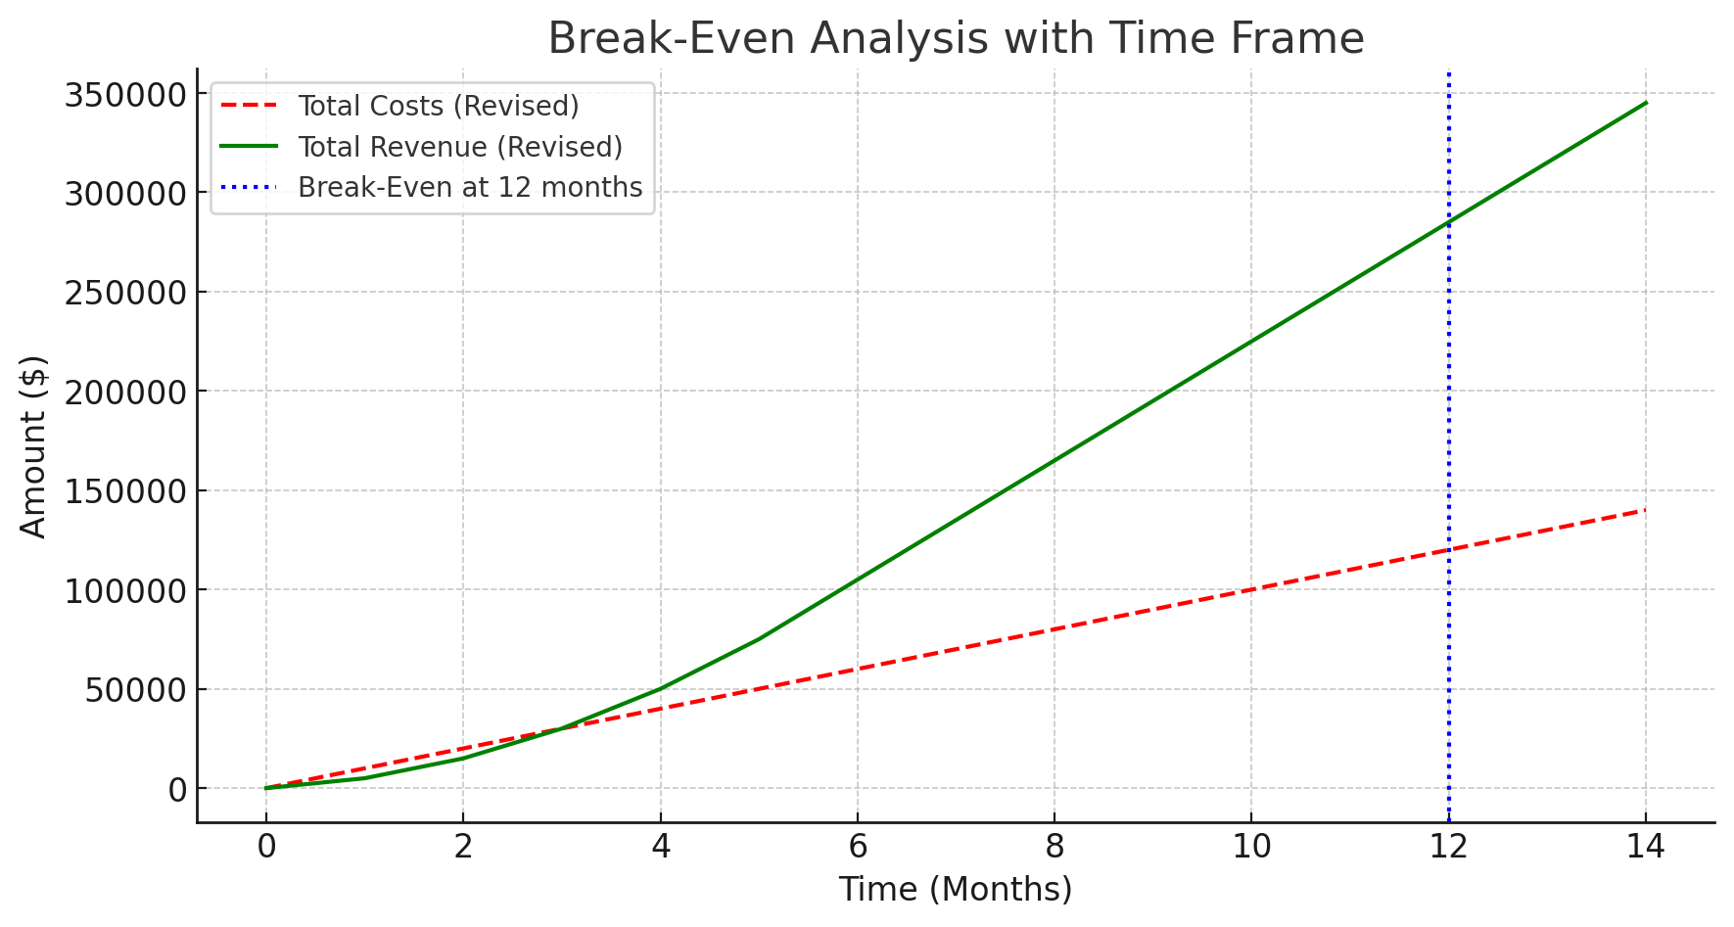

Break-Even Analysis

Slide 18

Questions & Answers

